Slide 1
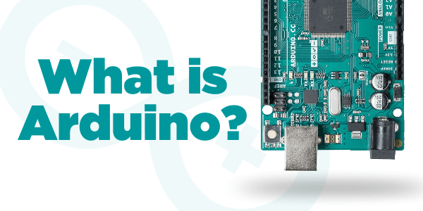


57
Menu
Notes:
Introduce Arduino. Then move to the open-source description.

Slide 2

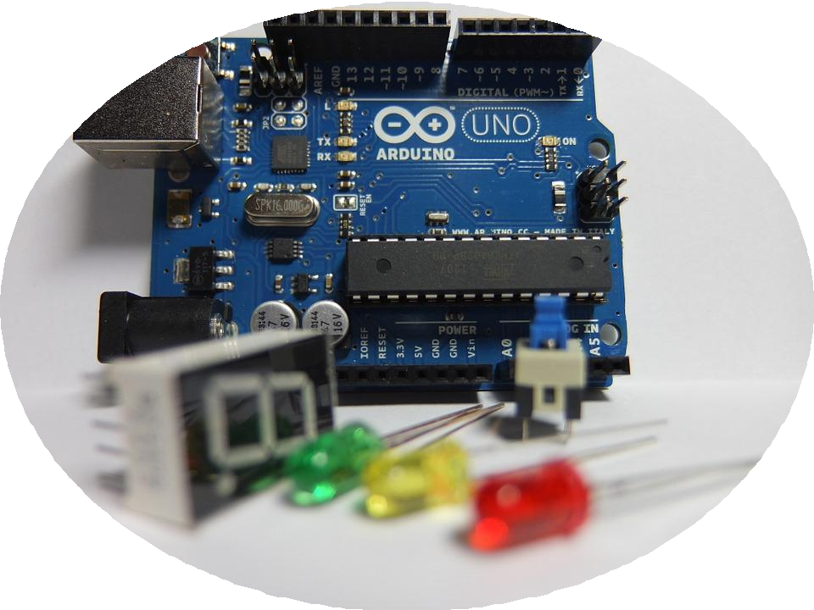
ARDUINO
Arduino Microcontroller
Open-source electronics platform based on easy-to-use hardware and software.
Are able to read inputs - light on a sensor, a finger on a button, or a Twitter message - and turn it into an output - activating a motor, turning on an LED, publishing something online.
58
Menu

Slide 3
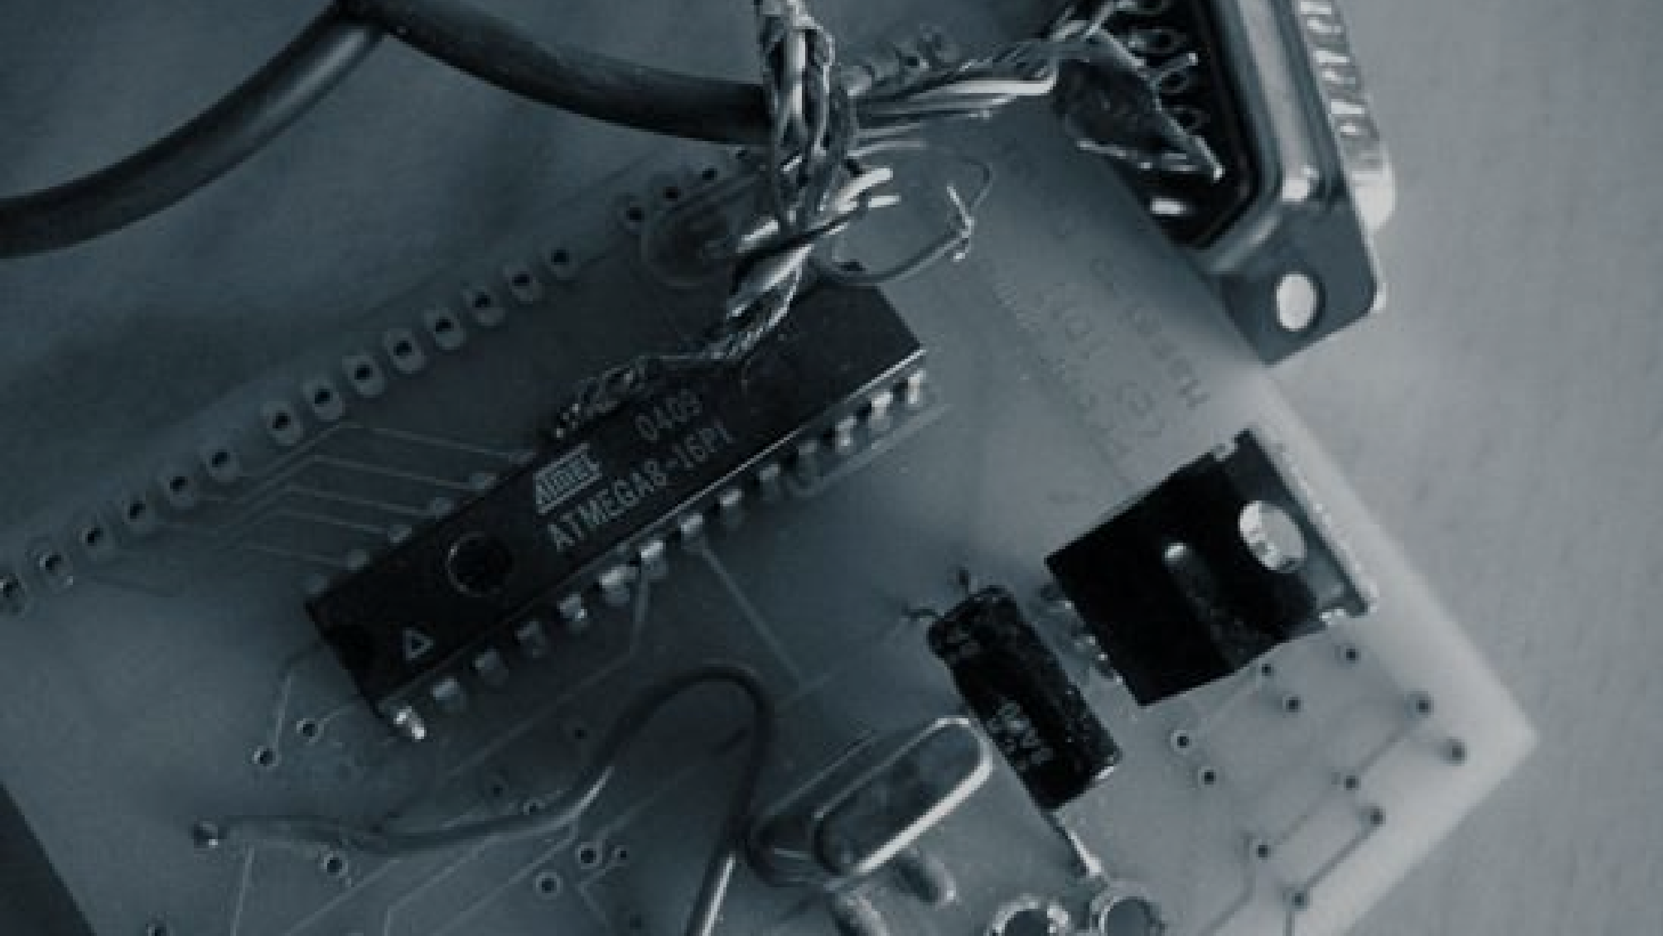

ARDUINO
MICROCONTROLLER
A brief story.
The Arduino project began in 2005 as a tool for students at the Interaction Design Institute Ivrea in Ivrea, Italy, aiming to provide a low-cost and easy way for novices and professionals to create devices that interact with their environment using sensors and actuators.
59
Menu
Notes:
A brief story of Arduino.

Slide 4
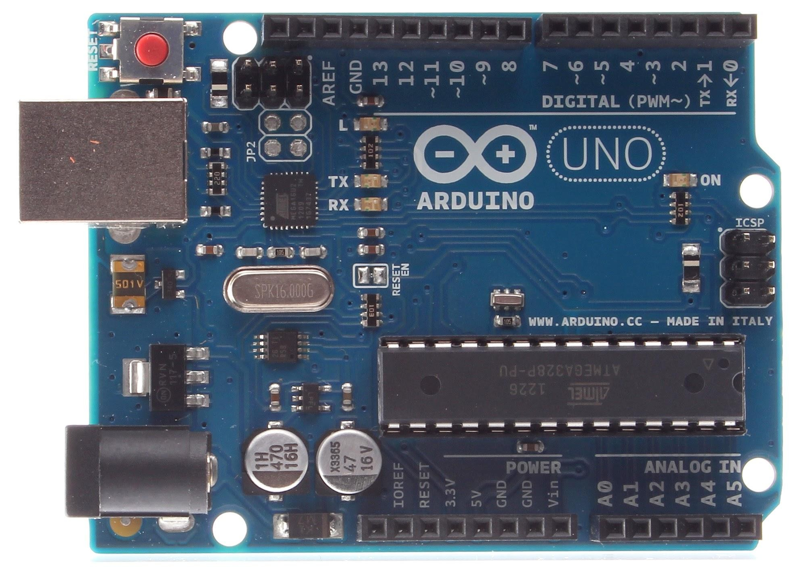
ARDUINO
Arduino Uno
Digital output 0, 1 Serial Port
USB port
In circuit serial programming
ATMEL Microcontroller
Power input
Power supply
Analog input
60
Menu
Notes:
Point to each labelled part on the board. The colour of each label matches the coloured box in the original diagram.

Slide 5
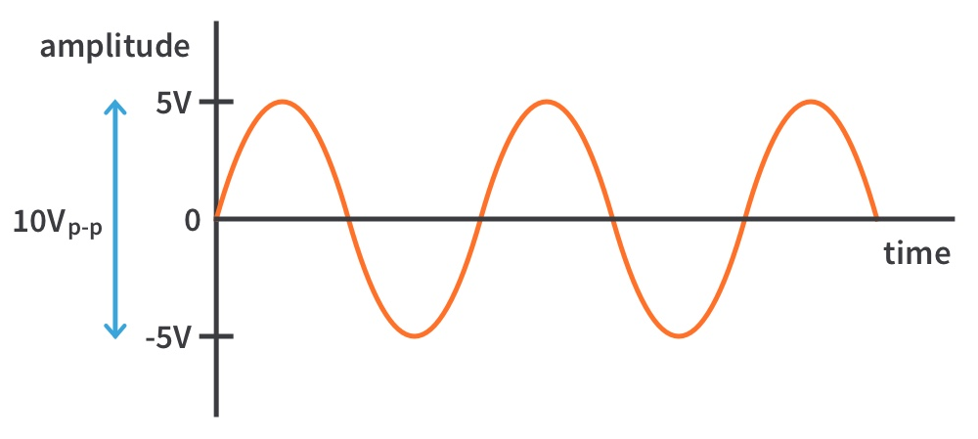
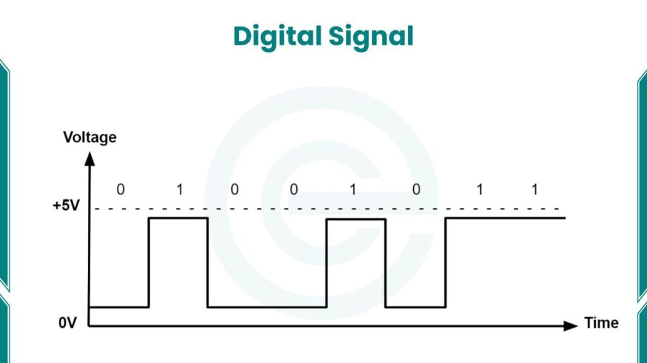
ARDUINO
Analog and digital pins
The Arduino can input and output analog signals as well as digital signals.
An analog signal is one that can take on any number of values, unlike a digital signal which has only two values: HIGH and LOW.
61
Menu
Notes:
Compare a smooth analog wave to a square digital wave.

Slide 6
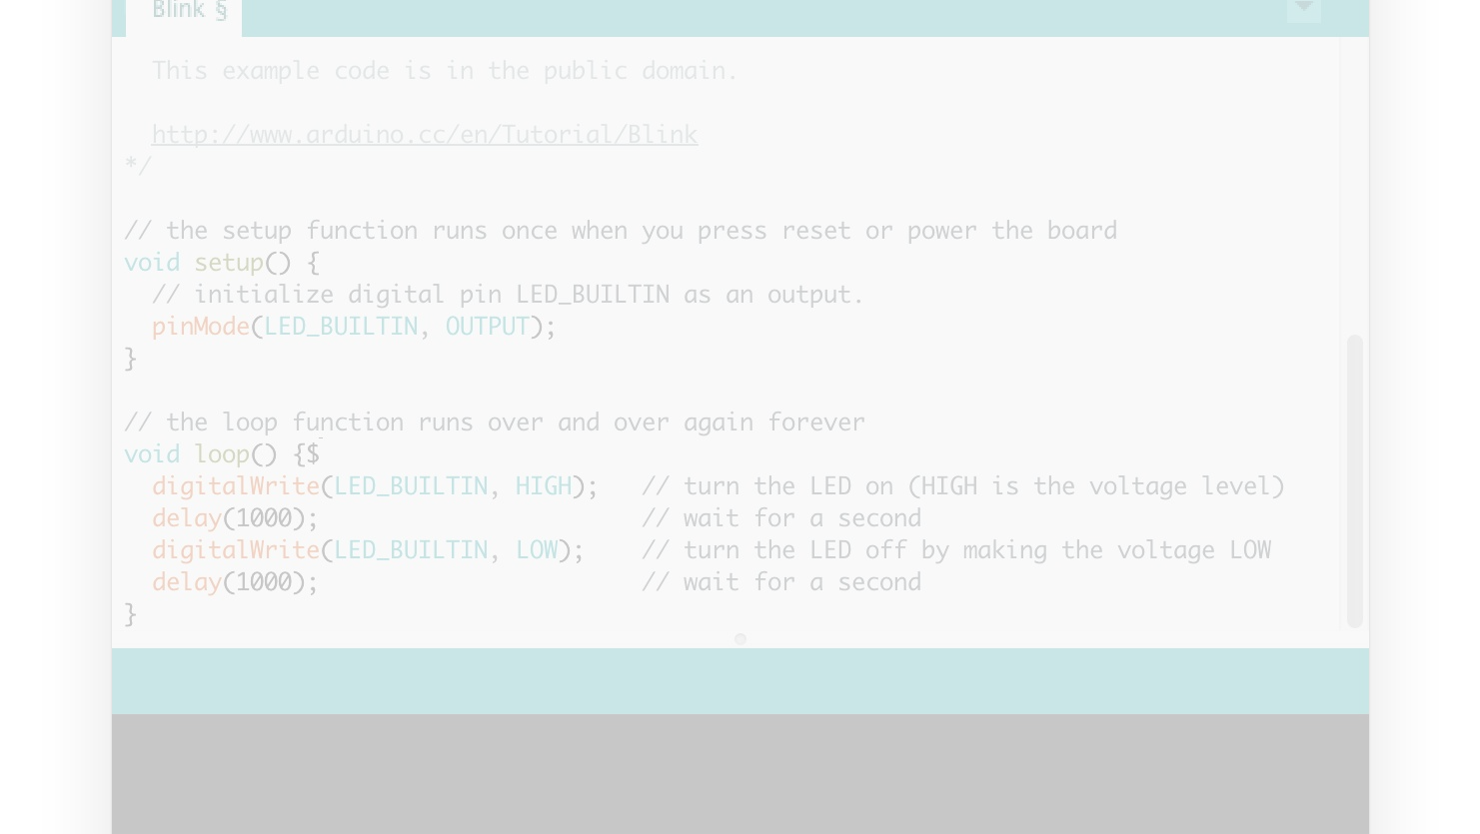

Arduino Software
How Arduinos are programmed
62
Menu
Notes:
Transition slide: how Arduinos are programmed.

Slide 7
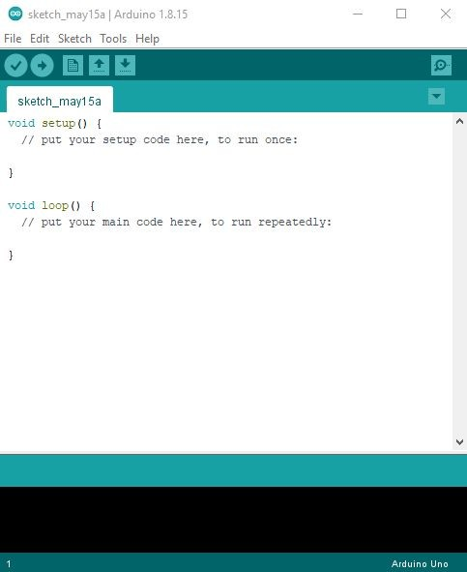

ARDUINO
Arduino Software (IDE)
The Arduino Integrated Development Environment - or Arduino Software (IDE)
- contains a text editor for writing code, a message area, a text console, a toolbar with buttons for common functions and a series of menus. It connects to the Arduino hardware to upload programs and communicate with them.
63
Menu
Notes:
Open the Arduino IDE and point at each area.

Slide 8

ARDUINO
Arduino Language
Simplified C/C++
Peripheral libraries
LCD
sensors
12C
ect.
64
Menu
Notes:
Arduino code is simplified C/C++ with helper libraries.

Slide 9
ARDUINO
Useful functions
pinMode()
set pin as input or output
digitalWrite()
set a digital pin high/low
digitalRead()
read a digital pin’s state
analogRead()
read an analog pin
analogWrite()
write an “analog” PWM value
delay()
wait an amount of time
65
Menu
Notes:
Ask students to guess what each function does before you explain it.

Slide 10

ARDUINO
Sketch
Global variables
Declare variables at the top
setup( )
Initialize
setup( ) - run once at the beginning
set pins
loop( )
loop( ) - run repeatedly after setup( )
66
Menu
Notes:
Every Arduino sketch has global variables, setup() and loop().

Slide 11
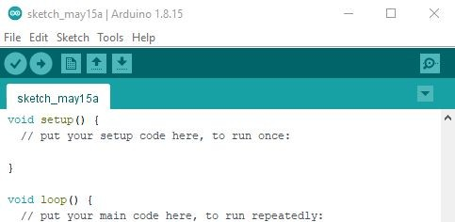
ARDUINO
IDE Toolbar
1
VERIFY
2
Upload
1
3
5
6
3
New sketch
2
4
4
Opens
5
Save
6
Search
67
Menu
Notes:
Point to each toolbar button in the live IDE.

Slide 12
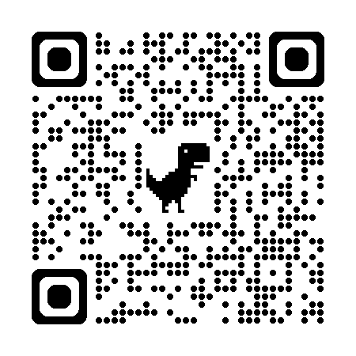

Slide 13
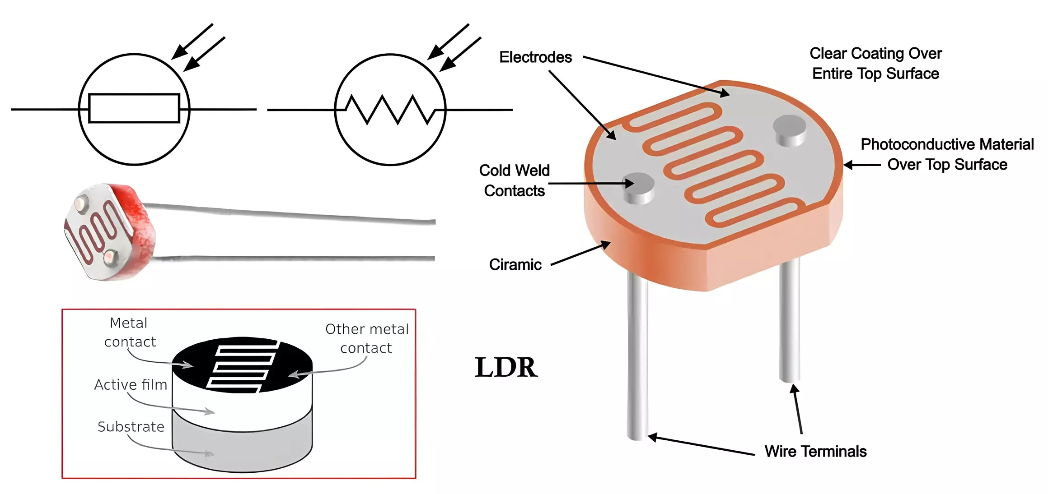

Slide 14
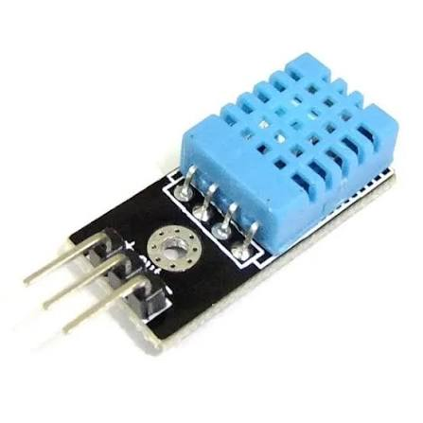
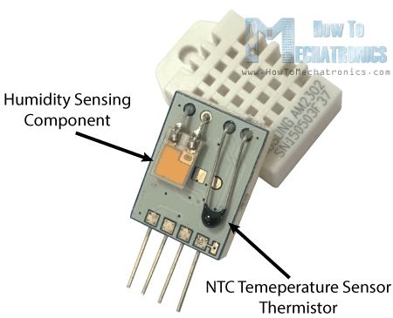
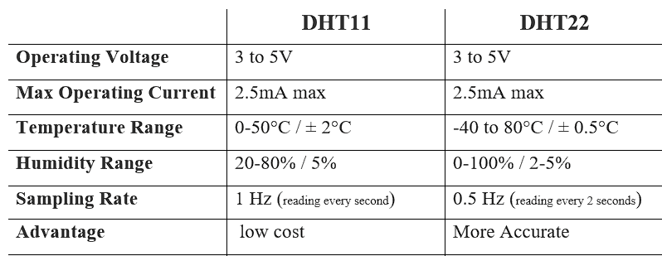

Slide 15
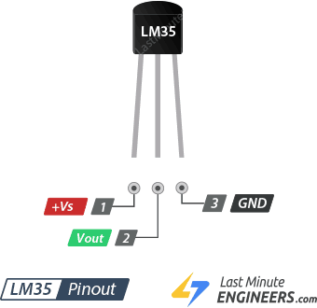

Slide 16
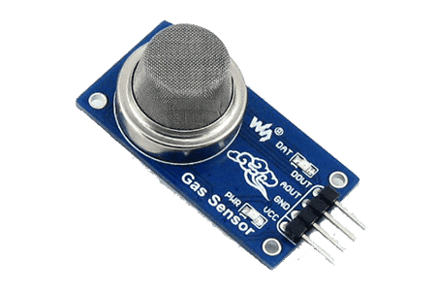
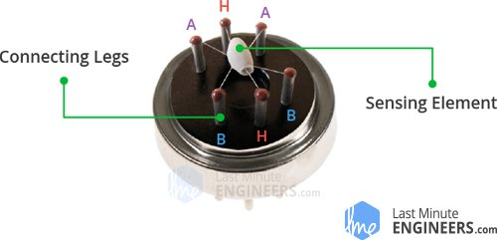

Slide 17
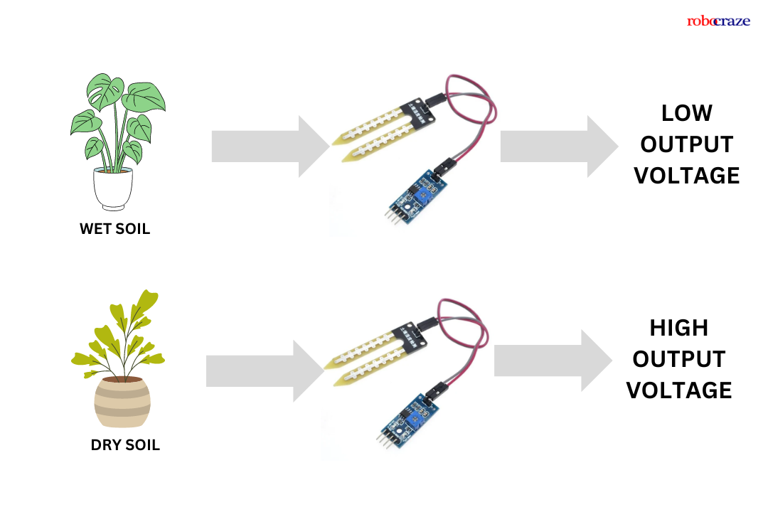

Slide 18
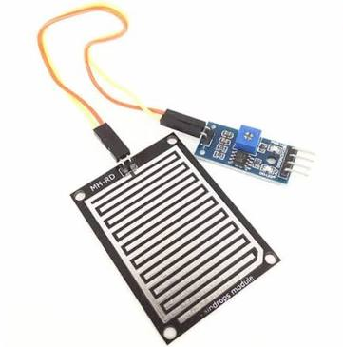
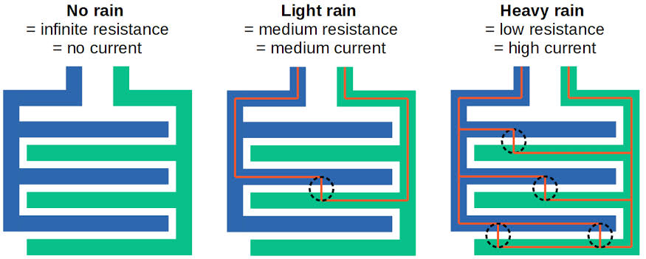

Slide 19
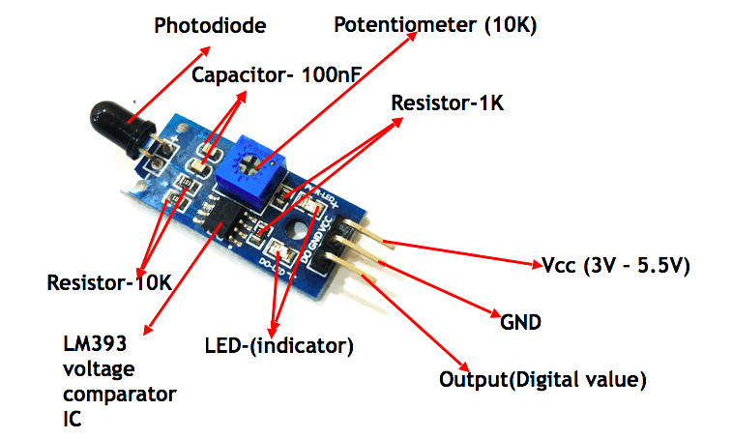

Slide 20
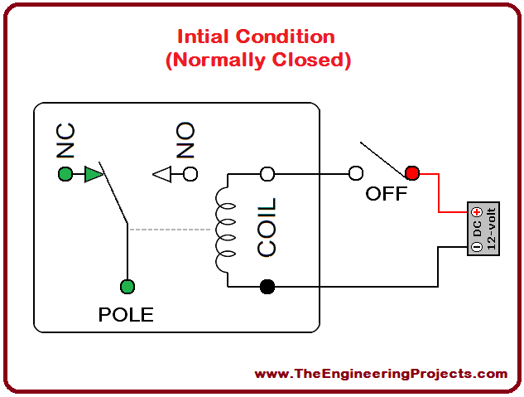
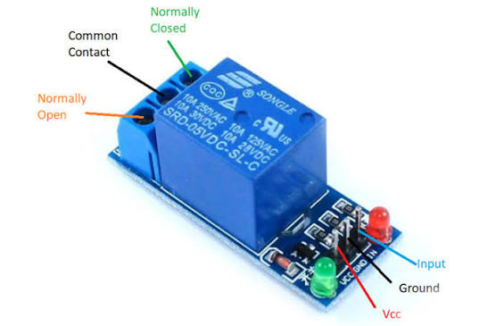

Slide 21
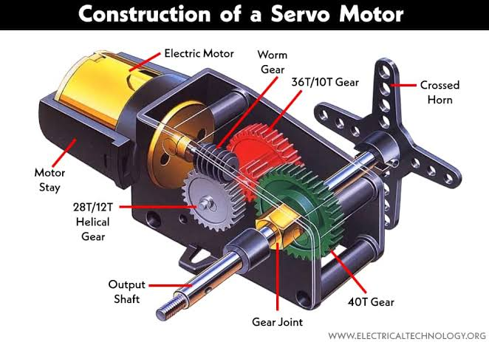
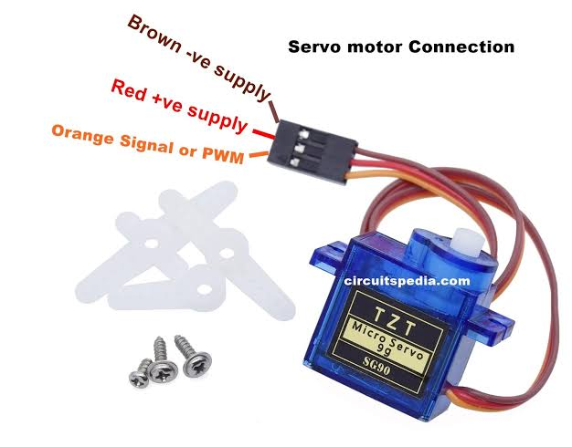

Slide 22
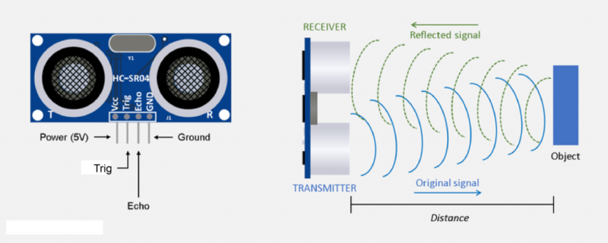

Slide 23
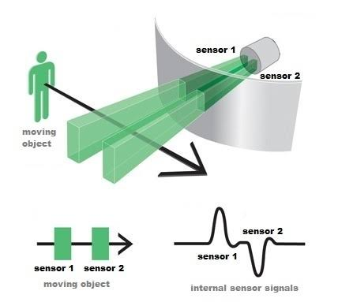
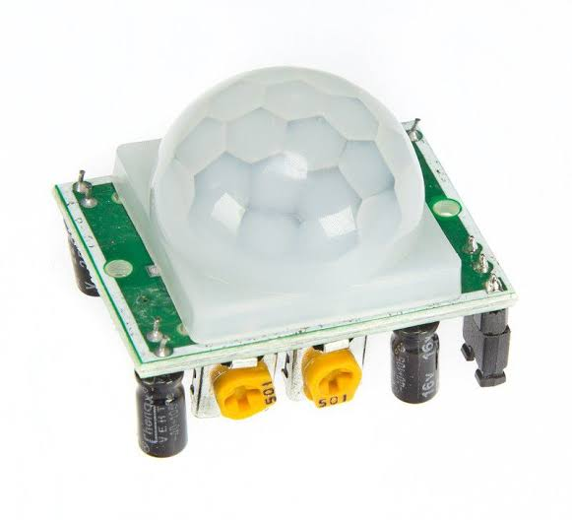

Slide 24


